Slide 1
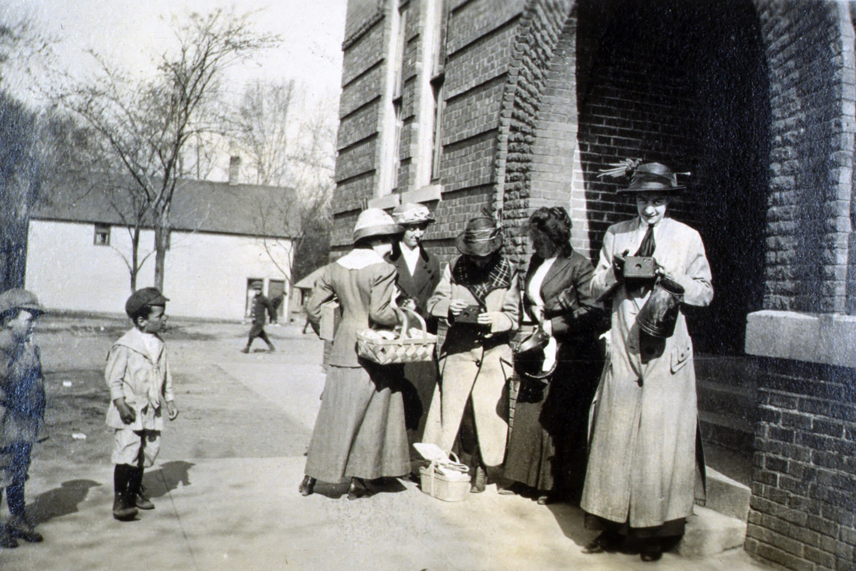
What’s Old is New
dmschools.org
flickr.com/dmps
Notes:
Spring of 1912
Cattell Elementary School in Des Moines
Appear to be teachers/students/school picnic
Note: two teachers with camera
Photography nothing new when it comes to education

Slide 2
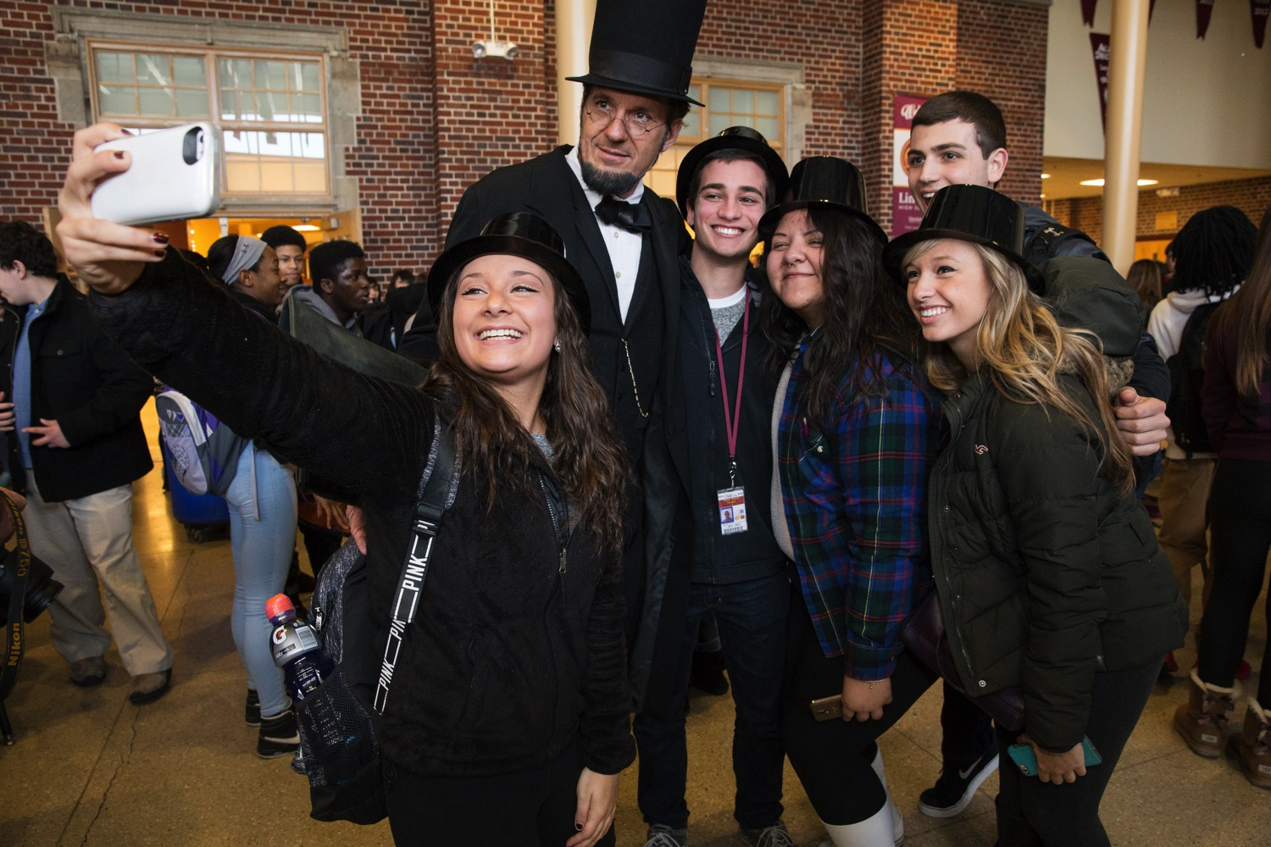
Photography Matters More Than Ever
dmschools.org
flickr.com/dmps
Notes:
Jump ahead 100 years
What is new:
Photography is omnipresent
Photography is immediate
Photography easily shared on multiple platforms
This photo illustrates those changes
Photography and education more important than ever
What we'd like to cover:
Photography critical to effective communications
Our approach at DMPS

Slide 3
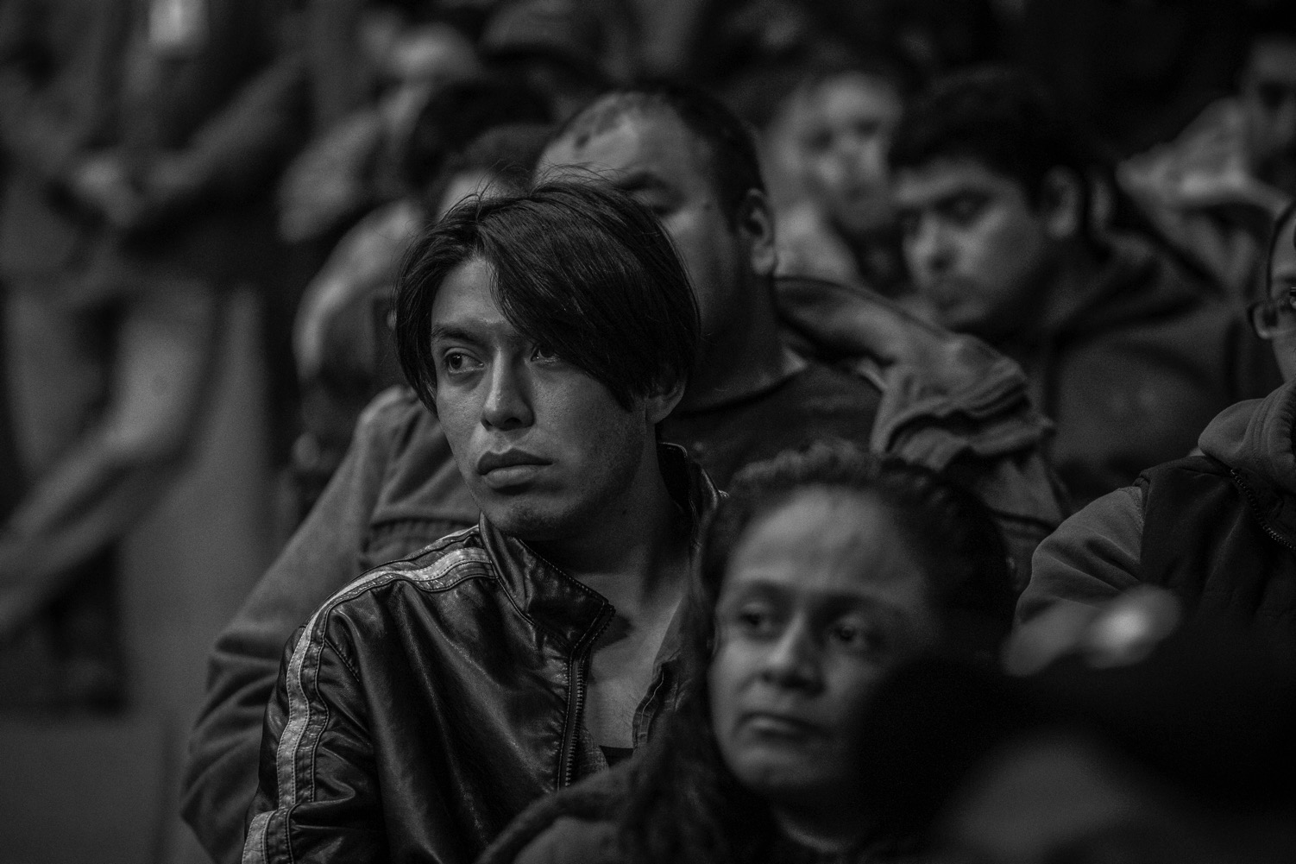
Education Photography Should Be Good Photography
dmschools.org
flickr.com/dmps
Notes:
Also talk about some elements of good photography
Education photography can/should be good photography
We all have interesting material to work with (most good, some bad)
Compelling images around us each and every day
[note about this photo]

Slide 4
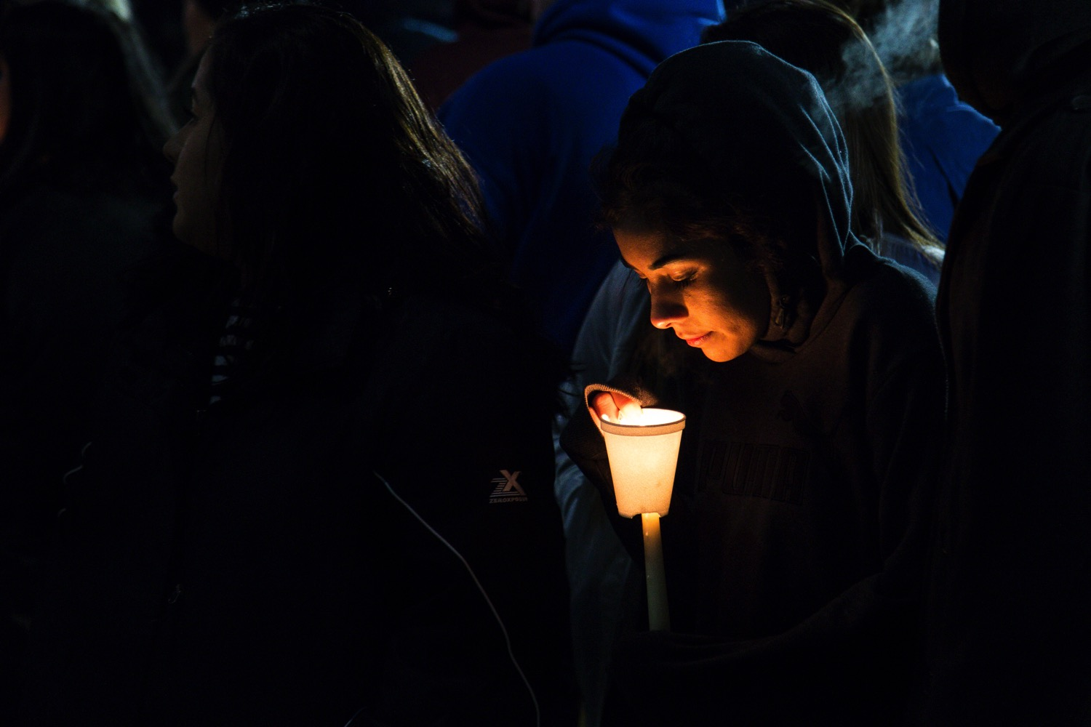
“So what are photographs good at? While they can’t tell stories, they are brilliant at suggesting stories.” - Alec Soth
dmschools.org
flickr.com/dmps
Notes:
Alec Soth quote
vs
picture worth a thousand words
1/500 of a second isn't a story
Words can be what you fill in about a photo
OR
Entice viewer to dig deeper
OK with former; prefer the latter

Slide 5
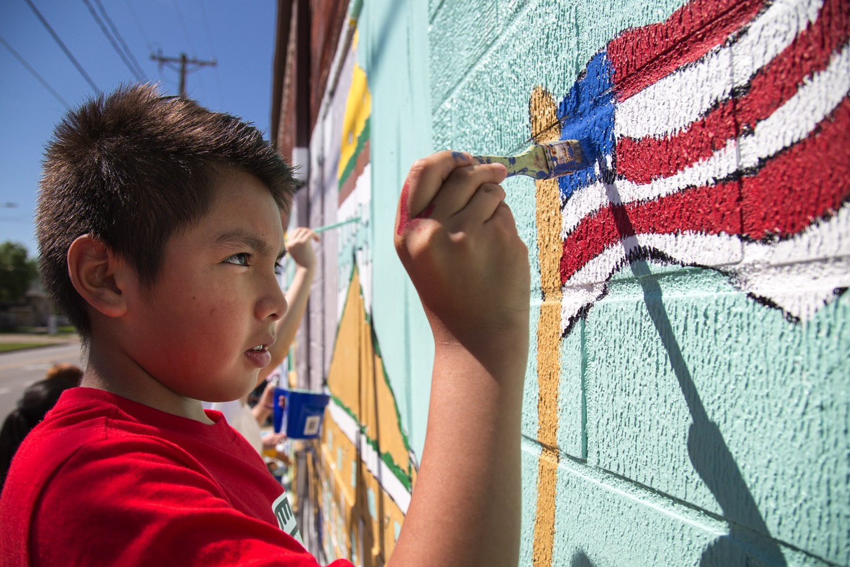
Our Approach to Photography
dmschools.org
flickr.com/dmps
Notes:
Straight-forward, good, honest, compelling photos
Photojournalism/documentary style
Entire comm team contributes to our photo work

Slide 6
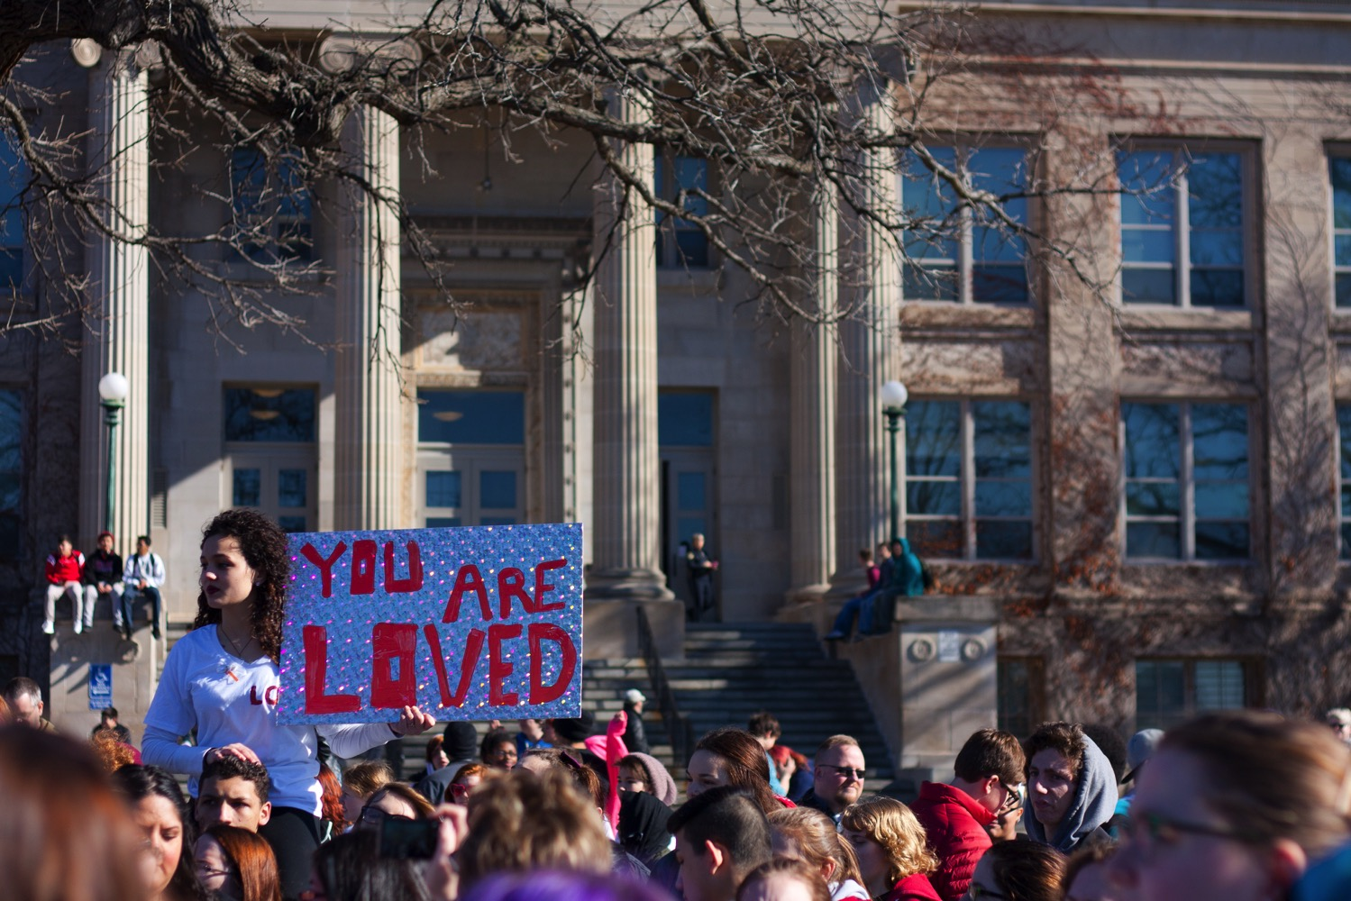
How We Use Photos
dmschools.org
flickr.com/dmps
Notes:
Try to capture a little bit of everything
Many are what you'd expect:
Sports
Concerts
Plays and musicals
Classroom projects
New facilities
Special guests
First/last day of school
graduations
etc, etc, etc
Also capture "controversy":
BLM
Walk-out
Westboro

Slide 7
Updates for Web Site
dmschools.org
flickr.com/dmps
Notes:
New web site
Very image driven
Used for blog stories as well as program content

Slide 8
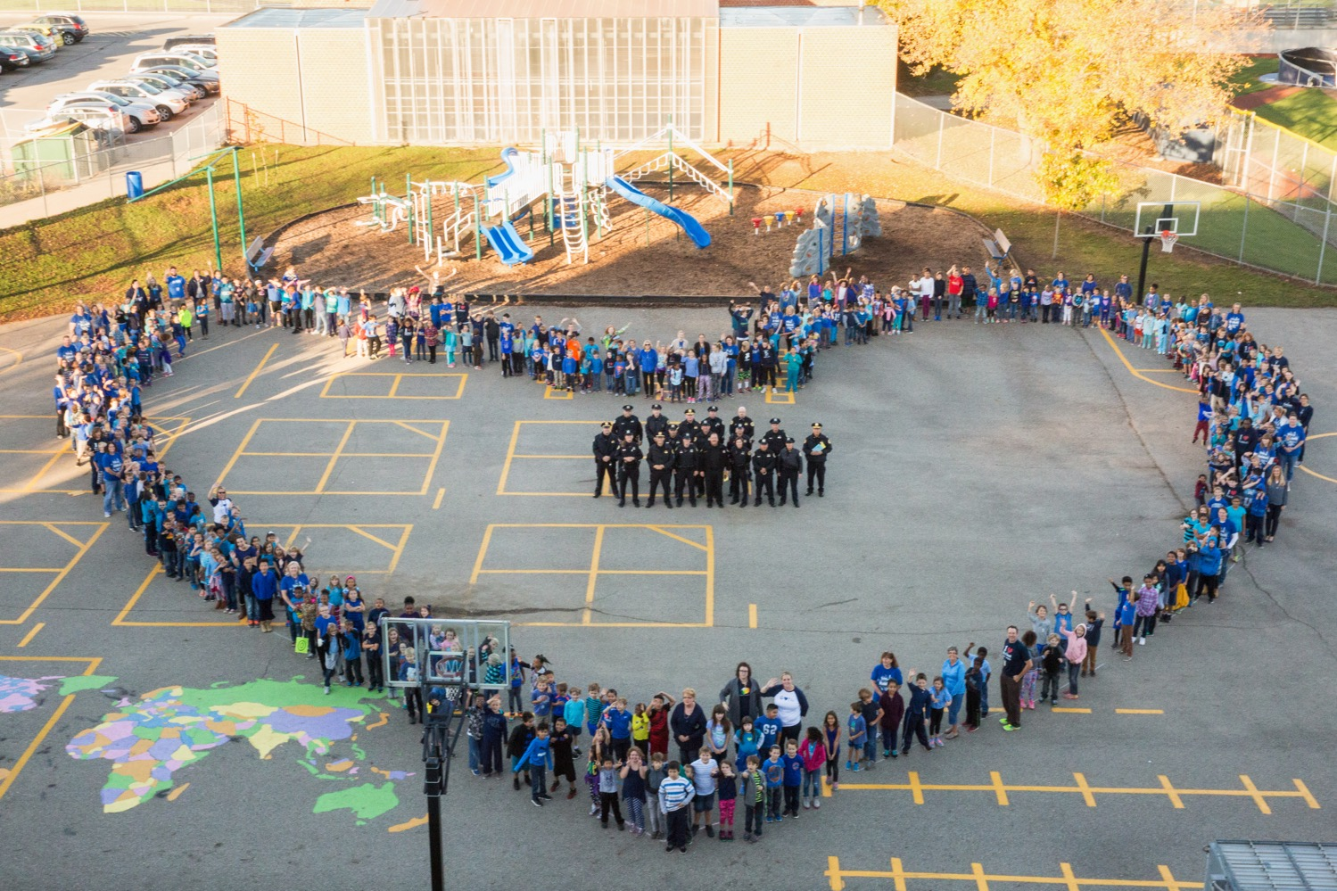
Share on Social Media
dmschools.org
flickr.com/dmps
Notes:
Rare that social media post does not include some sort of image - photo, video, graphic
Instagram - most engaged social media platform
Note on this photo - most viewed Facebook post

Slide 9
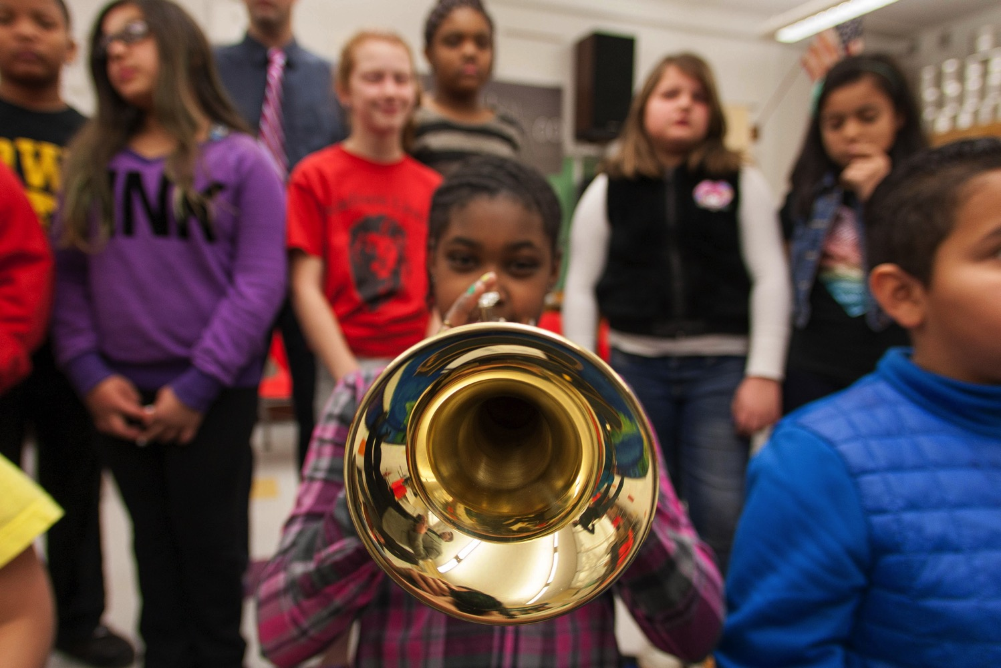
Content for Marketing
dmschools.org
flickr.com/dmps
Notes:
Provides original material for:
Newsletter
Annual reports and publications
Digital billboards
Print ads
Building signing and decoration

Slide 10
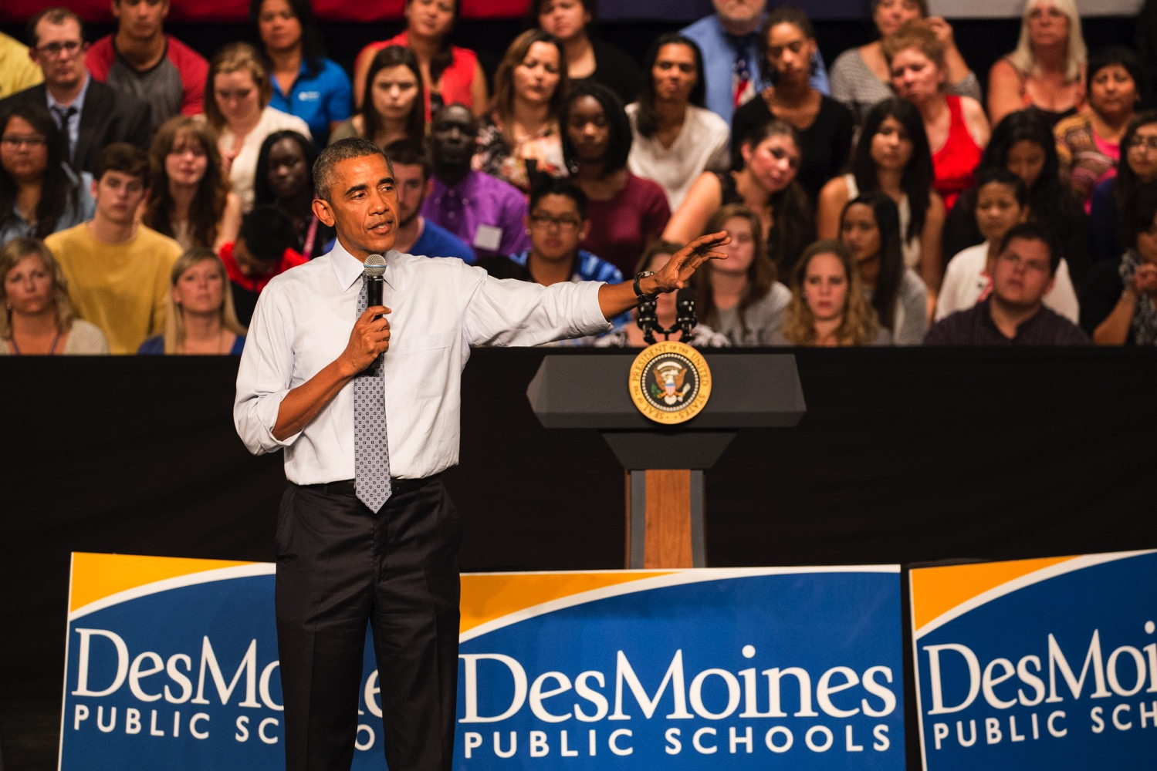
Content for News Media
dmschools.org
flickr.com/dmps
Notes:
This guy stopped by school one day . . .
TV/Radio web sites
Walk-out (ABC News, Reuters)
DMR - community section

Slide 11
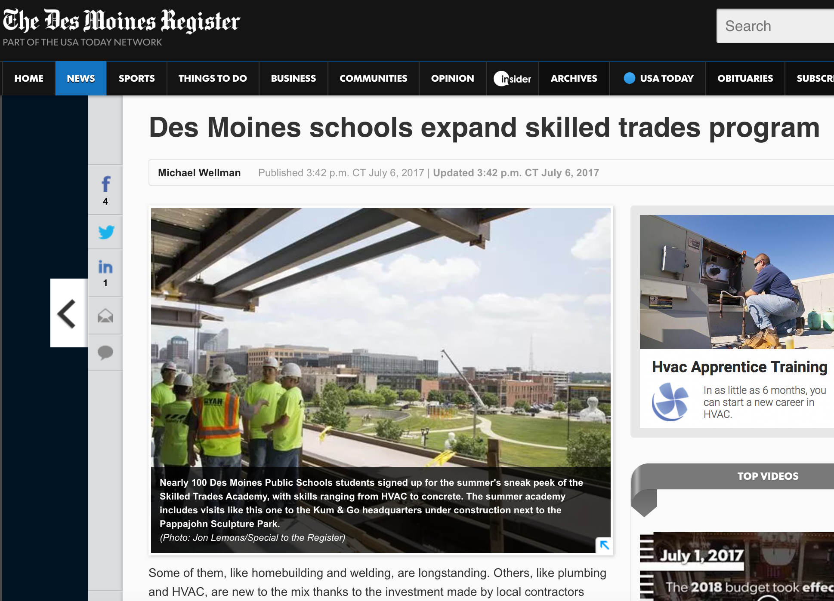
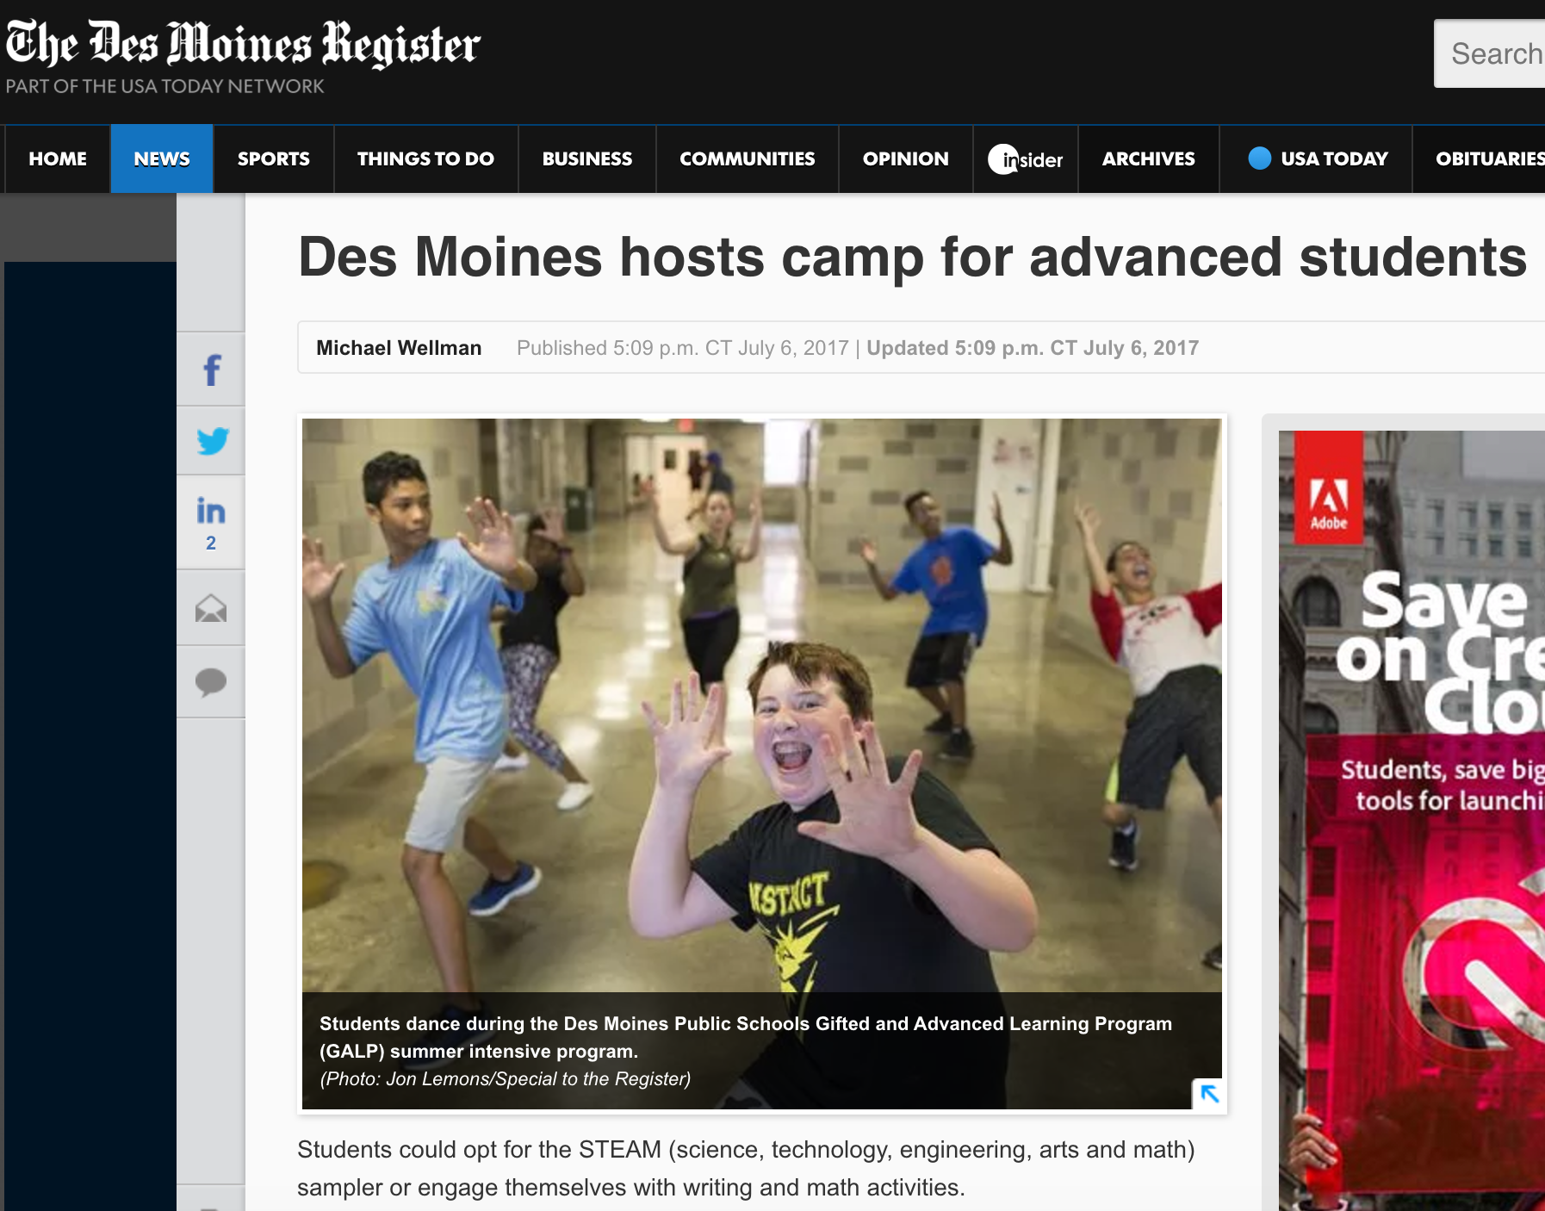
dmschools.org
flickr.com/dmps
Notes:
From Thursday's paper
Note byline and photo credit
Many of the groups we work with view us as media, want us to cover them

Slide 12
Sharing
dmschools.org
flickr.com/dmps
Notes:
We can't be everywhere
School staff can provide good photos
TechCon experience

Slide 13
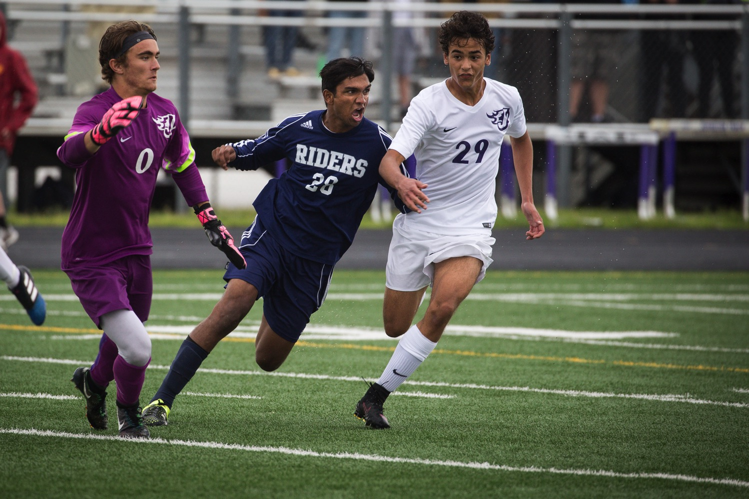
Building A Photo Archive
dmschools.org
flickr.com/dmps
Notes:
Result of work is extensive photo library
38K images over past 5-6 years
Use Flickr: price is right, unlimited storage, easy to organize, social media friendly
Provides resource to support comm efforts

Slide 14
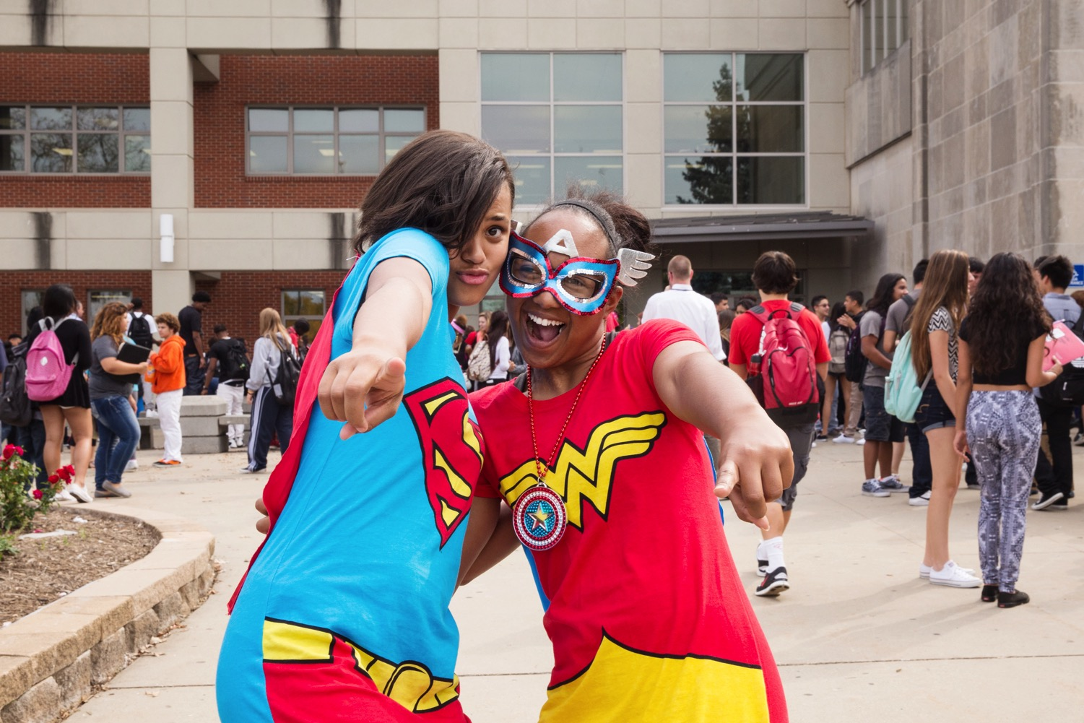
Why Photos Matter
dmschools.org
flickr.com/dmps
Notes:
Suggesting stories
AND
Bring public inside our schools

Slide 15
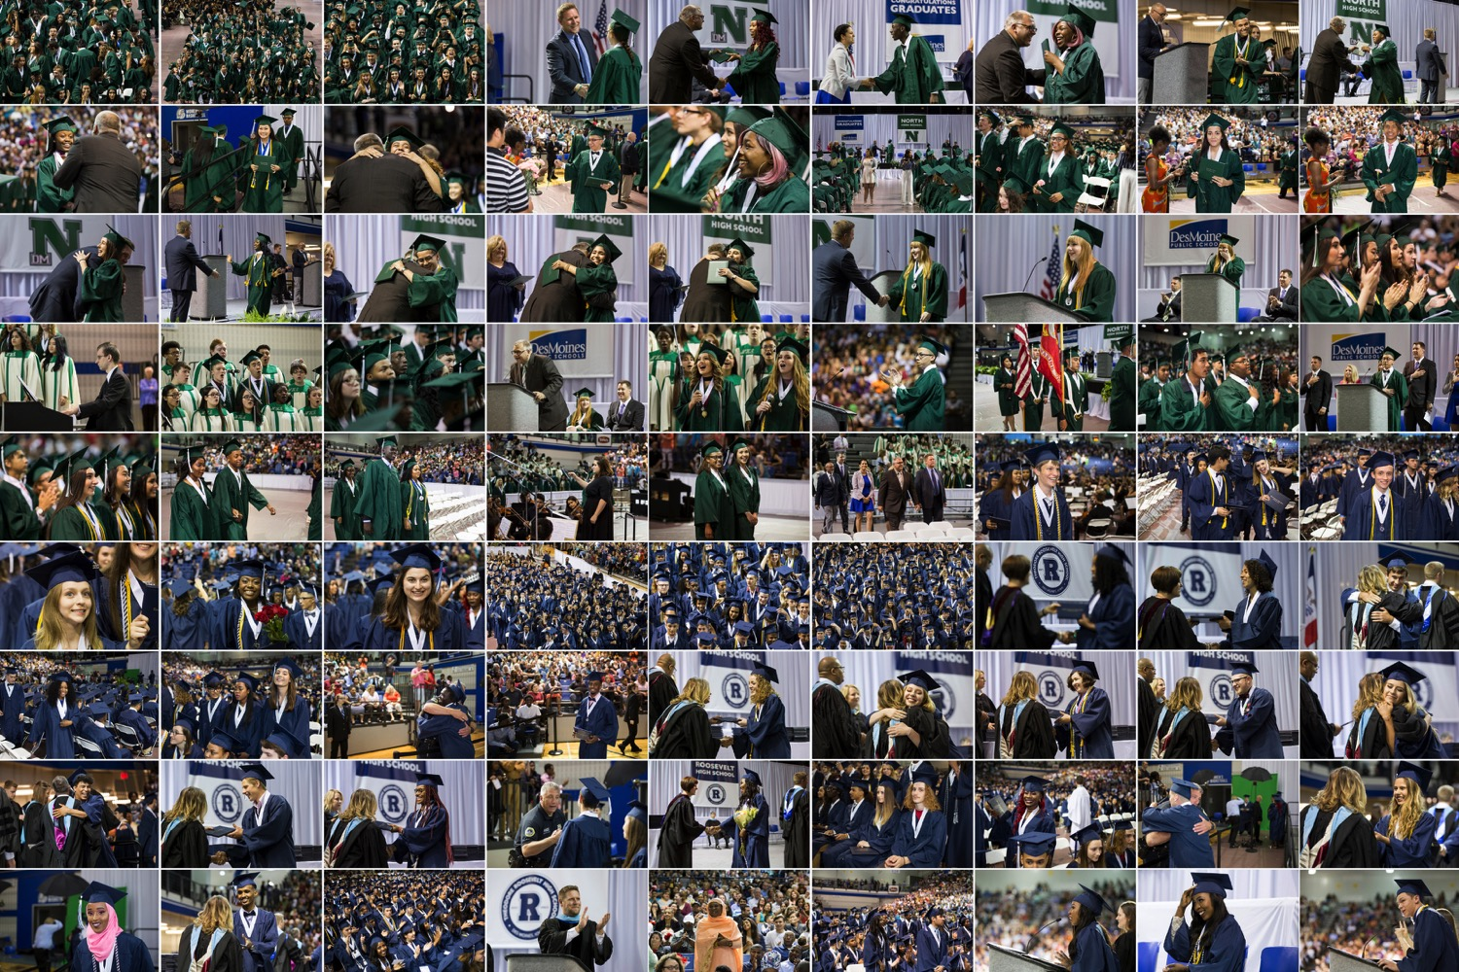
Why Good Photos Matter More
dmschools.org
flickr.com/dmps
Notes:
Last year: 380 billion images uploaded to internet
More than total photos in all previous years
Lots of bad/cat photos to look at
AND
Lots of competition to get people's attention
Good, compelling images help to do just that

Slide 16
PHOTOGRAPHY = PHOS + GRAPHE or LIGHT + WRITING
dmschools.org
flickr.com/dmps
Notes:
term coined term in 1839.
created combining greek words.
writing has many styles like fiction, nonfiction, poetry or journalism.
same for photography, posed photography, or art photography, or landsape photography, or photojournalism.
photojournalism to help tell a story or to cover an event.
I'm going to talk about some guidelines I use for shooting photojournalism photos

Slide 17
LIGHT SUBJECT BACKGROUND
COMPOSE MOMENT
dmschools.org
flickr.com/dmps
Notes:
5 steps I use for finding and taking photos.
simple and intuitive, but when brought together they elevate image beyond thoughtless snapshot.

Slide 18
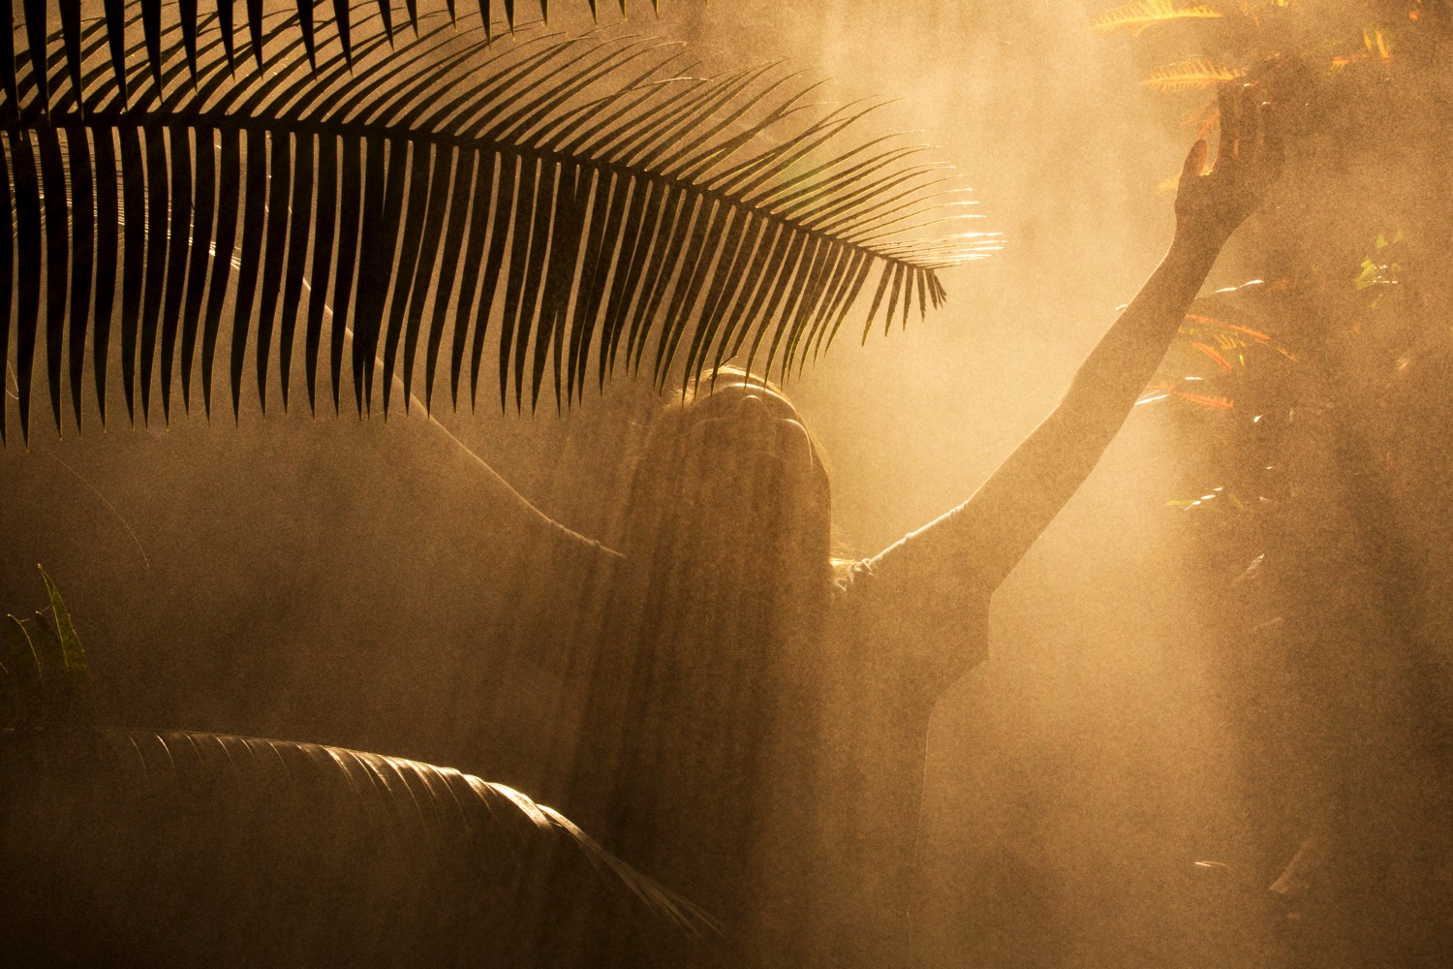
#1 - Find the Light
dmschools.org
flickr.com/dmps
Notes:
Find the Light.
Raise your hands if you've taken a photo of your lens cap..
no matter how many photos i take..

Slide 19
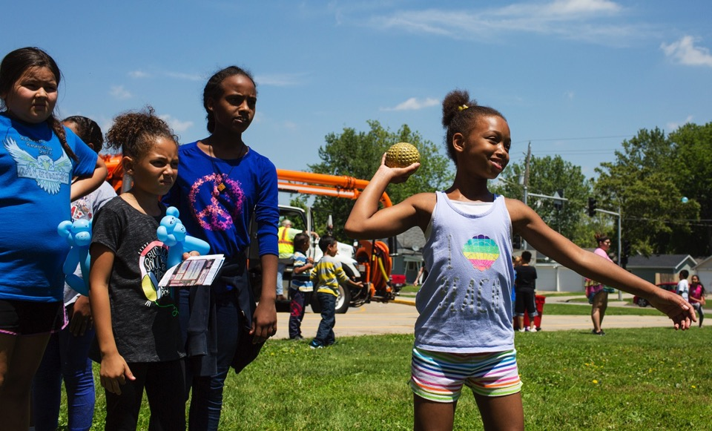
Not All Light is Good Light
dmschools.org
flickr.com/dmps
Notes:
size of light source relative to the subject.
sun huge, but in the sky it's small.
small light sources create harsh shadows like a mean western movie.
instead we want a diffused light source like through a cloud or window or a from a reflection off of a wall

Slide 20
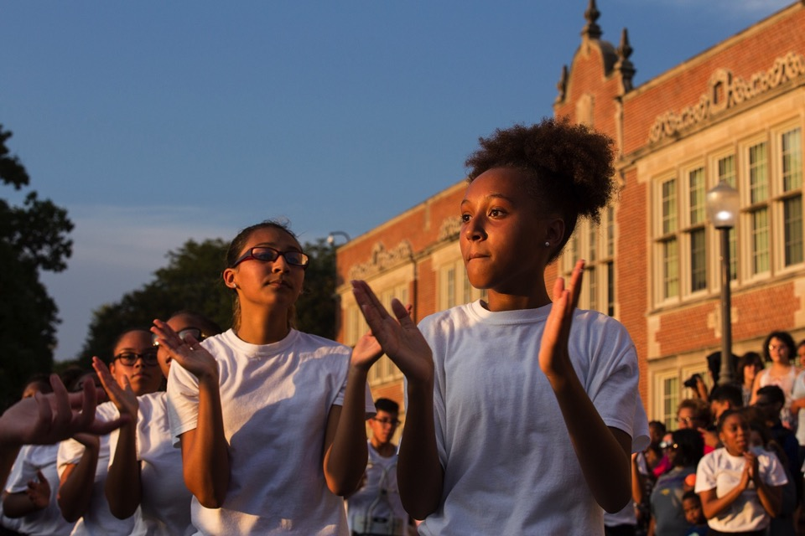
But Some Light is Golden
dmschools.org
flickr.com/dmps
Notes:
Photographers love to shoot during the golden hour --
near sunrise or sunset because the sun is diffused through the atmosphere.
softer light that illuminates the face

Slide 21
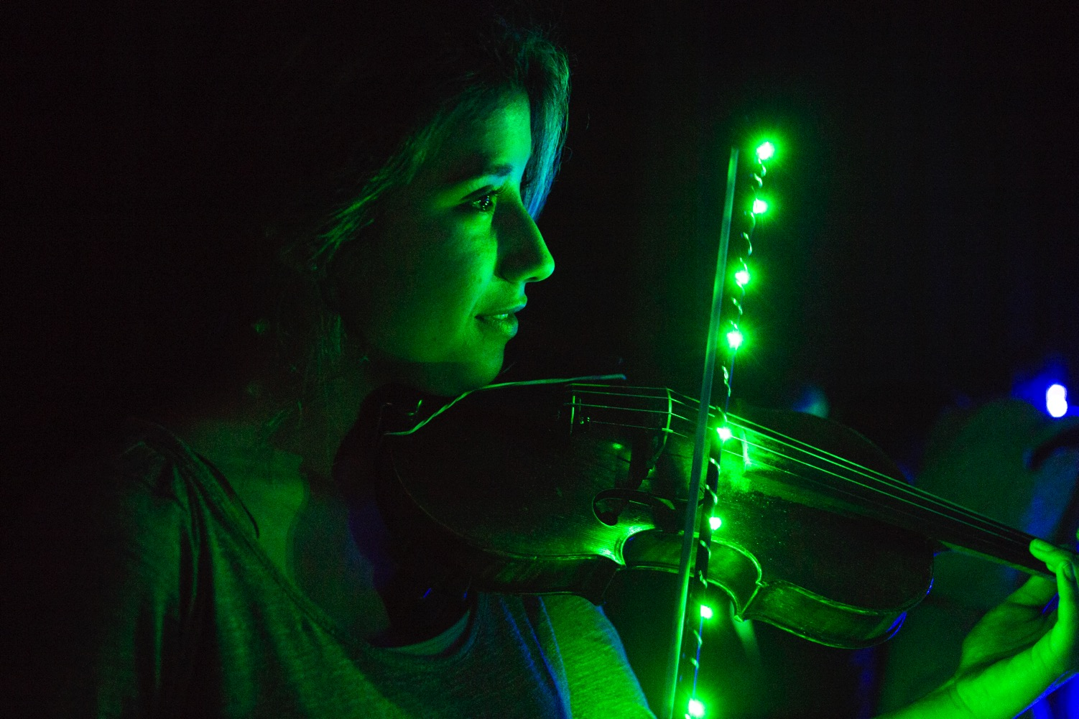
#2 - Find a Subject
dmschools.org
flickr.com/dmps
Notes:
Step 2 is to find a subject. We usually need a character to tell a story.

Slide 22
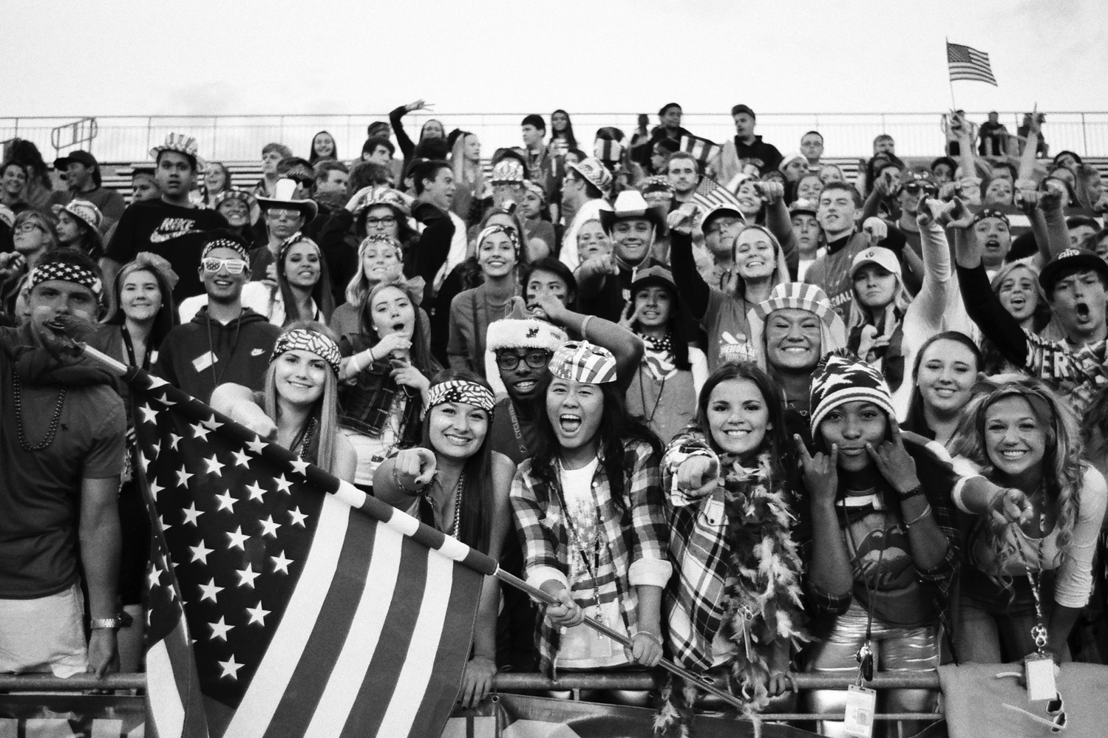
Or Find Many Subjects
dmschools.org
flickr.com/dmps
Notes:
Or lots of characters.
More smiling faces is better than one.

Slide 23
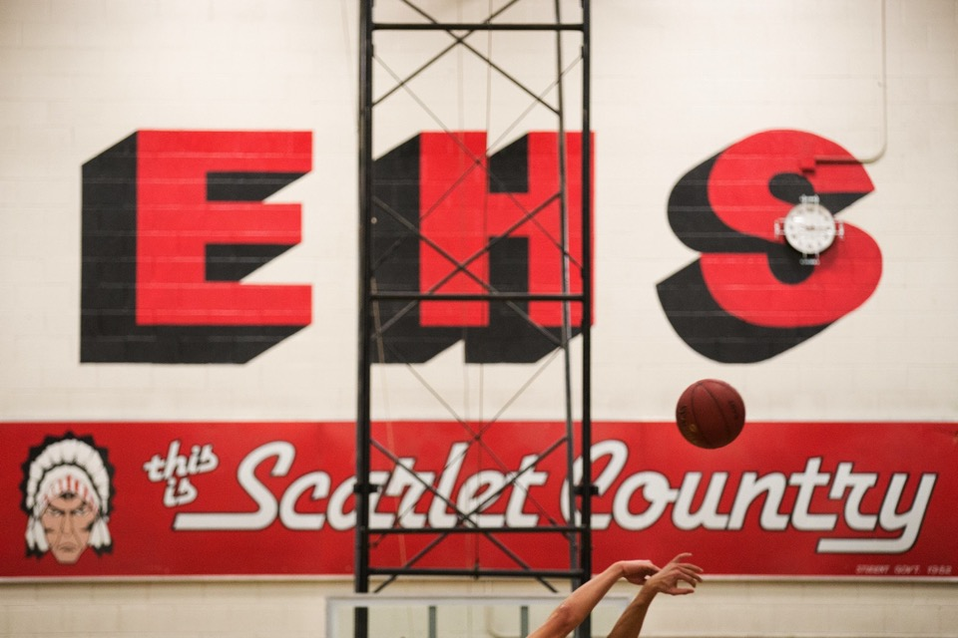
#3 - Find a Background
dmschools.org
flickr.com/dmps
Notes:
And we need a setting for our story.
We need a background.

Slide 24
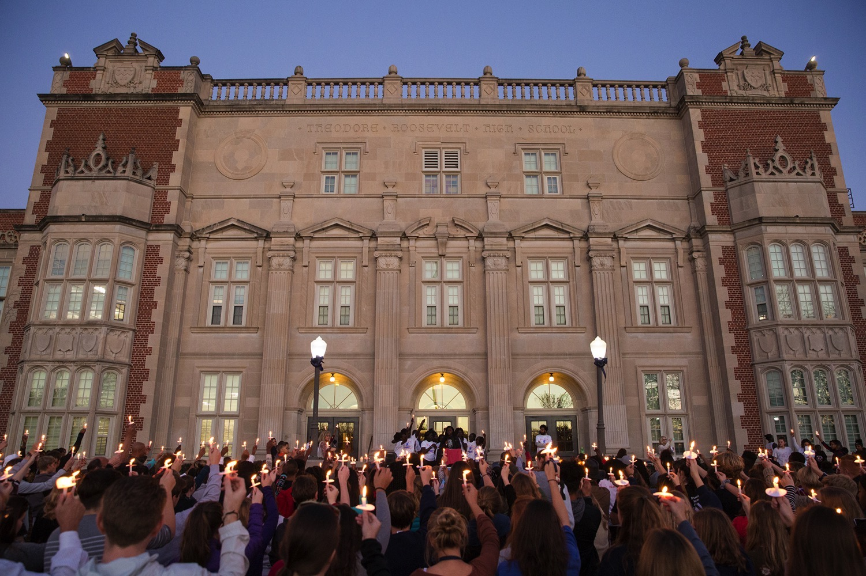
Provides Context
Notes:
this background provides context or a sense of place.

Slide 25
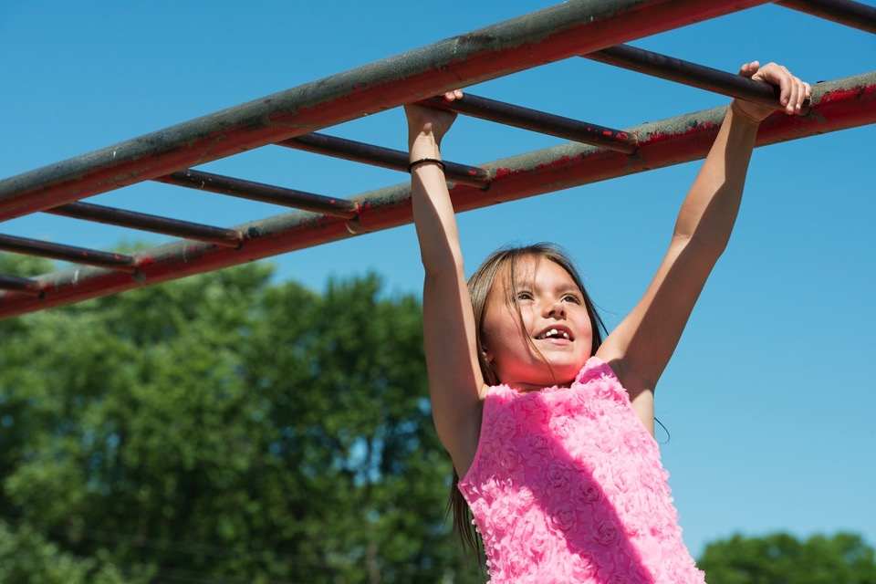
#4 - Compose
dmschools.org
flickr.com/dmps
Notes:
So now we have a scene with light, subject, and a background.
Now the work begins where we start to compose and anticipate where a photo might happen.
we want a composition that is easy to read and is balanced

Slide 26
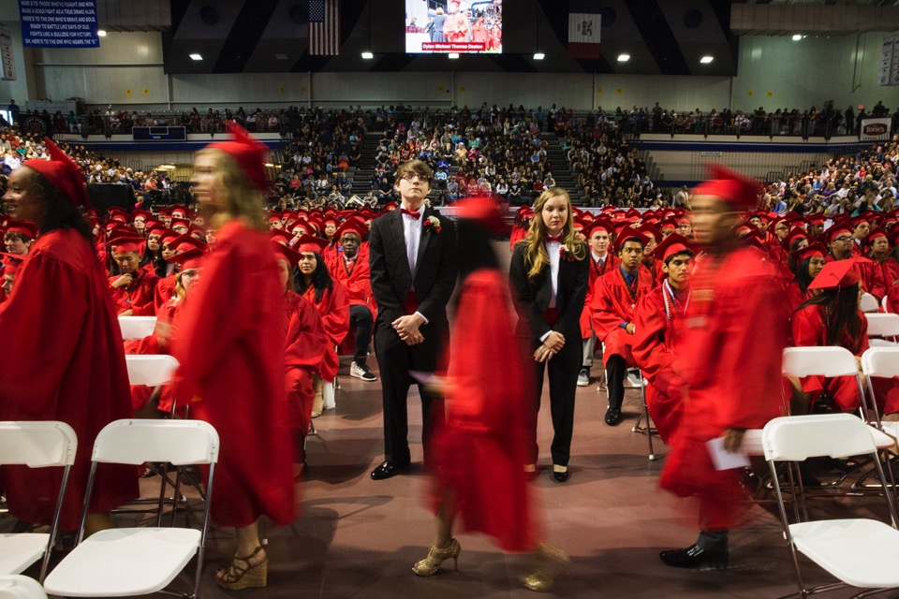
Hurry Up & Wait – Hold Steady
dmschools.org
flickr.com/dmps
Notes:
Hurry to a scene with light, subject, & background.
And we're starting to compose the image
I want to hold steady so the image isn't blurry.
waiting for...

Slide 27
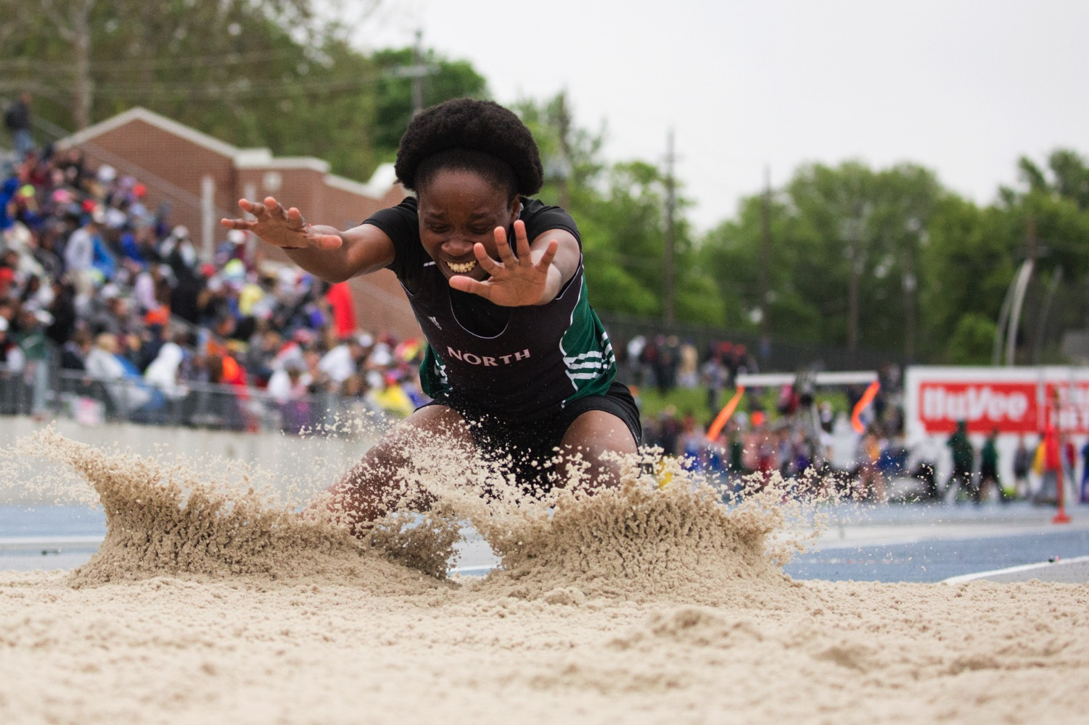
#5 – The Moment
dmschools.org
flickr.com/dmps
Notes:
something to happen.
I'm waiting for a moment like this track star reaching for more distance.
You could call this a dramatic moment or an obvious moment.

Slide 28
Quiet Moments
dmschools.org
flickr.com/dmps
Notes:
but there are other moments..
quieter moments that might not be so obvious.
like this student admiring her diploma.
Sometimes these quieter moments might provoke a different feeling or mood.

Slide 29
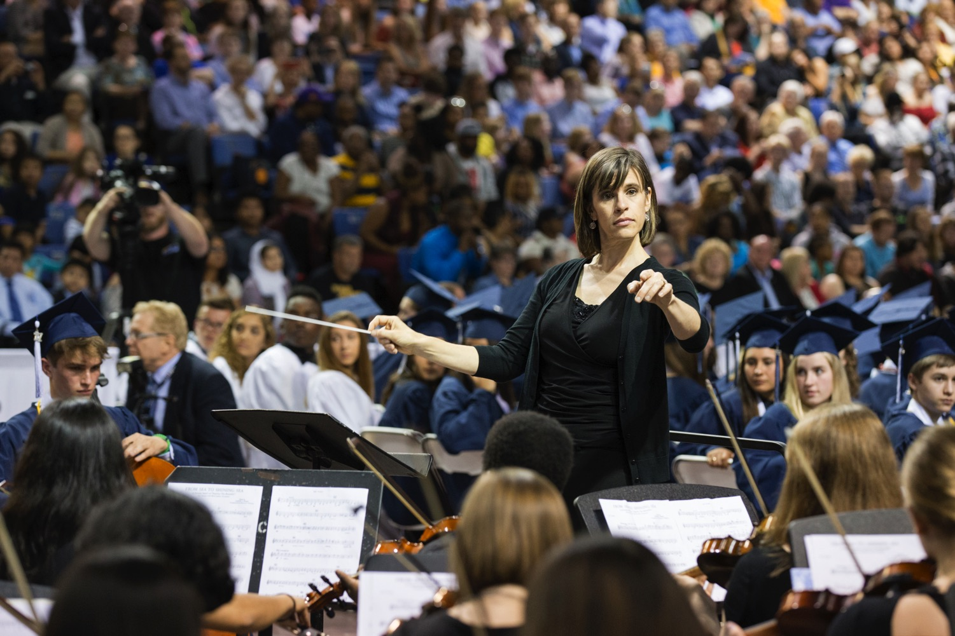
Gestures
dmschools.org
flickr.com/dmps
Notes:
Another type of moment is a gesture.
You can think of a band director starting a song.
Or me pointing up to this presentation.

Slide 30
Natural Expressions
dmschools.org
flickr.com/dmps
Notes:
Real or candid expressions only last for a moment.
Again shooting photojournalism, I didn't ask this girl to pose with her arm or to smile like this.
If i did, I don't think she would give me the same look.

Slide 31
The Moment is the Essence and Life of a Photo
dmschools.org
flickr.com/dmps
Notes:
These gestures and expressions are literally what I capture in a 1/500th of a second.
They're also what gives life to the image and make them interesting.

Slide 32
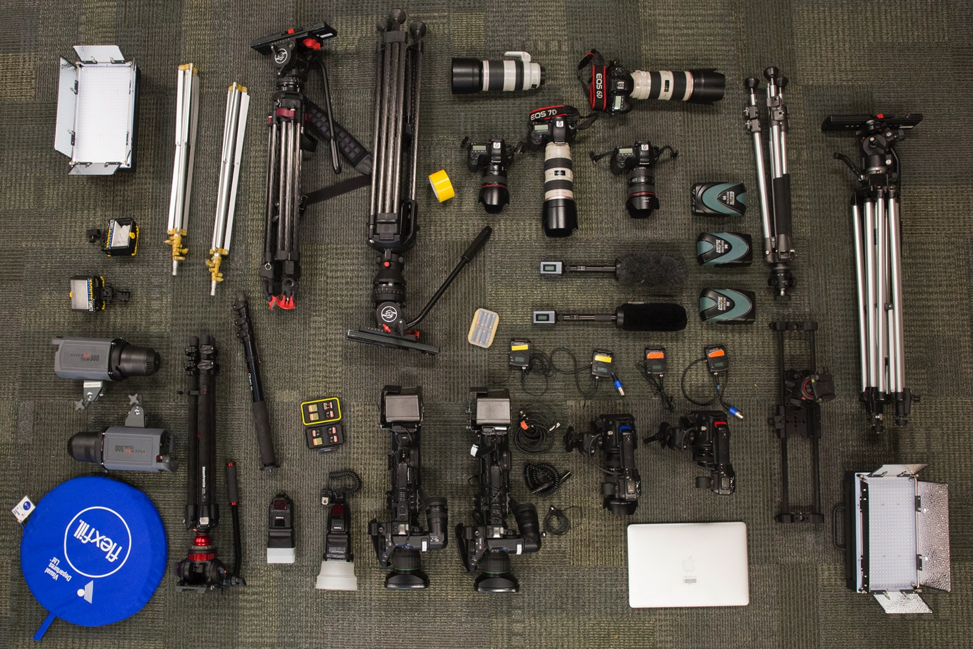
What’s In Your Bag?
dmschools.org
flickr.com/dmps
Notes:
With photography and video, easy to be a tech geek.
Cleared out our gear bags and TV car to give a look at what we use.

Slide 33
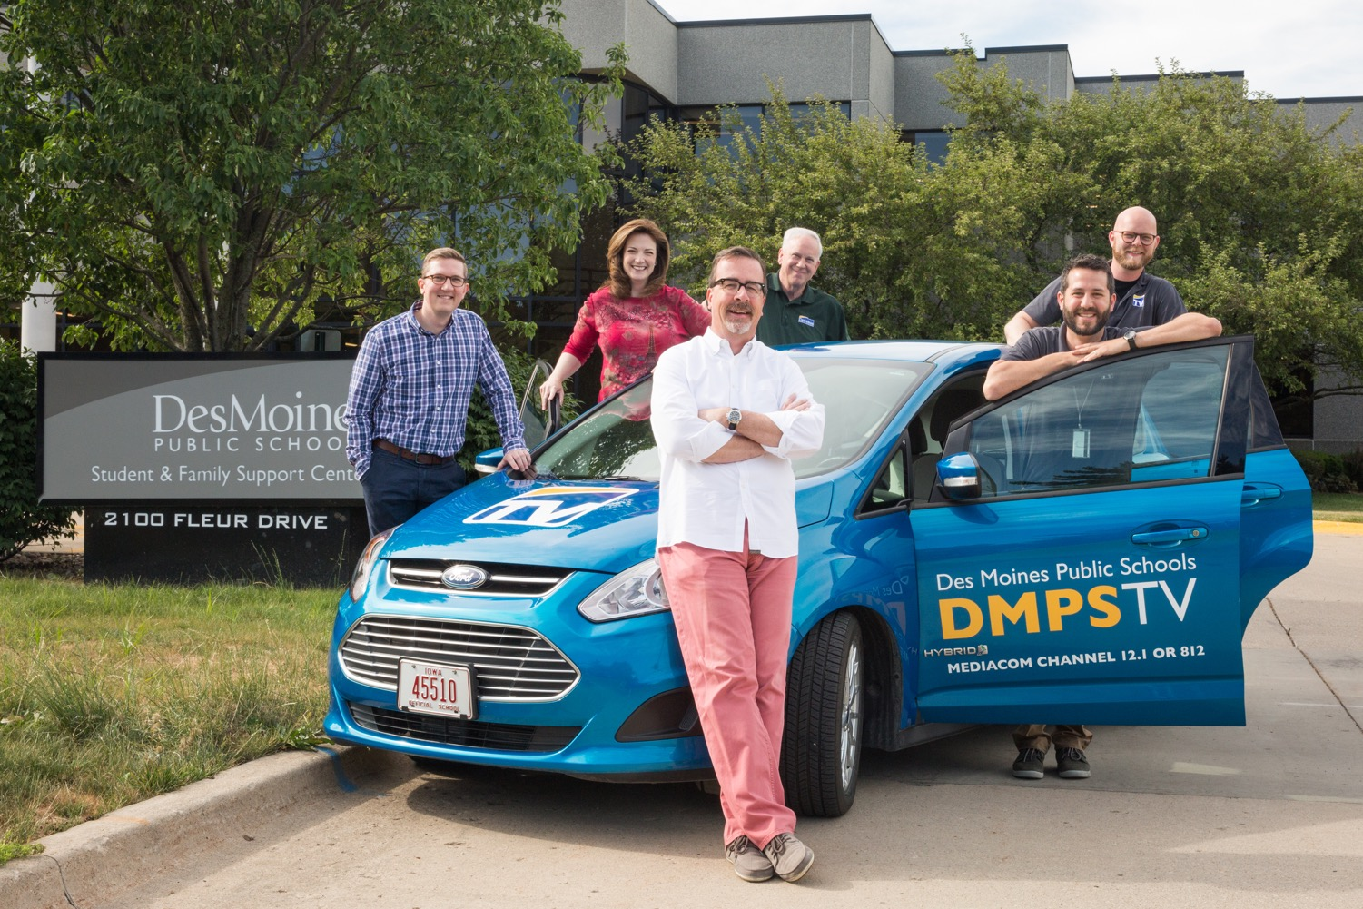
Yes, We Have a TV Car
dmschools.org
flickr.com/dmps
Notes:
Yes, we have a TV car

Slide 34
What’s In Your Bag?
dmschools.org
flickr.com/dmps
Notes:
Five DSLRs plus compact
Range of telephoto, zoom, prime lens
All the tripods, flashes, etc. we need
Video: switch from JVC to Canon C-line cameras: like the look, lighter, and use a variety of lenses
~$50K worth of gear

Slide 35
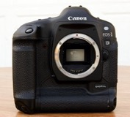
And What’s In Your Pocket?
The camera in today’s iPhone 7 has three-times the megapixels as Canon’s first professional digital camera introduced in 2001 … which sold for $4,999
dmschools.org
flickr.com/dmps
Notes:
What we carry in our pocket can do a good job when needed
Don't use zoom ... use your feet
Everything and everywhere is a photo op

Slide 36
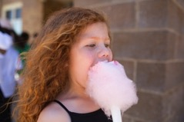
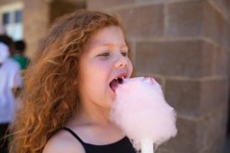
Digital Photos are Free
dmschools.org
flickr.com/dmps
Notes:
700 photos - 20 rolls of film - $200 for film + $100 to develop that film.
digital photography allows us to see our exposure and focus right now
It's free to reuse memory cards

Slide 37
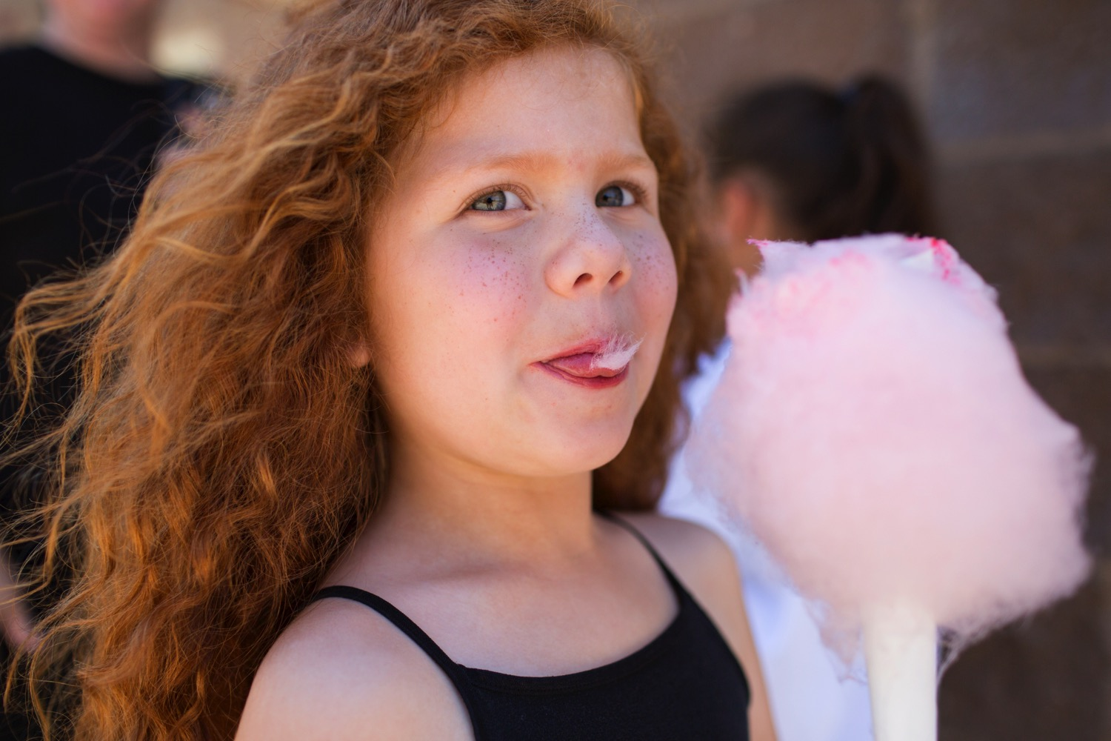
“If your pictures aren’t good enough,
you’re not close enough.” – Robert Capa
dmschools.org
flickr.com/dmps
Notes:
Magnum Photographer Robert Capa
Get Closer
Whole point of photography / portrait is for viewer to connect with a subject.
Personally, I shoot photography -- I want people to think and care about each other.
Wouldn't see this expression from 20 yards away.

Slide 38
Get Close & Have Fun
dmschools.org
flickr.com/dmps
Notes:
getting close simplifies the composition.
Again, a lot of this is intuitive, so I try to remember to just have fun.

Slide 39
“If you want to be a better photographer,
stand in front of better stuff.” - Jim Richardson
dmschools.org
flickr.com/dmps
Notes:
obvious statement from Nat Geo Jim Richardson
What is better / important / significant.
---------------
As I mentioned earlier, we are all fortunate in our work to have lots of better stuff happening before our eyes each and every day
Q&A at the end
plus a little group photo project
turn over to Dave

